Slide 1
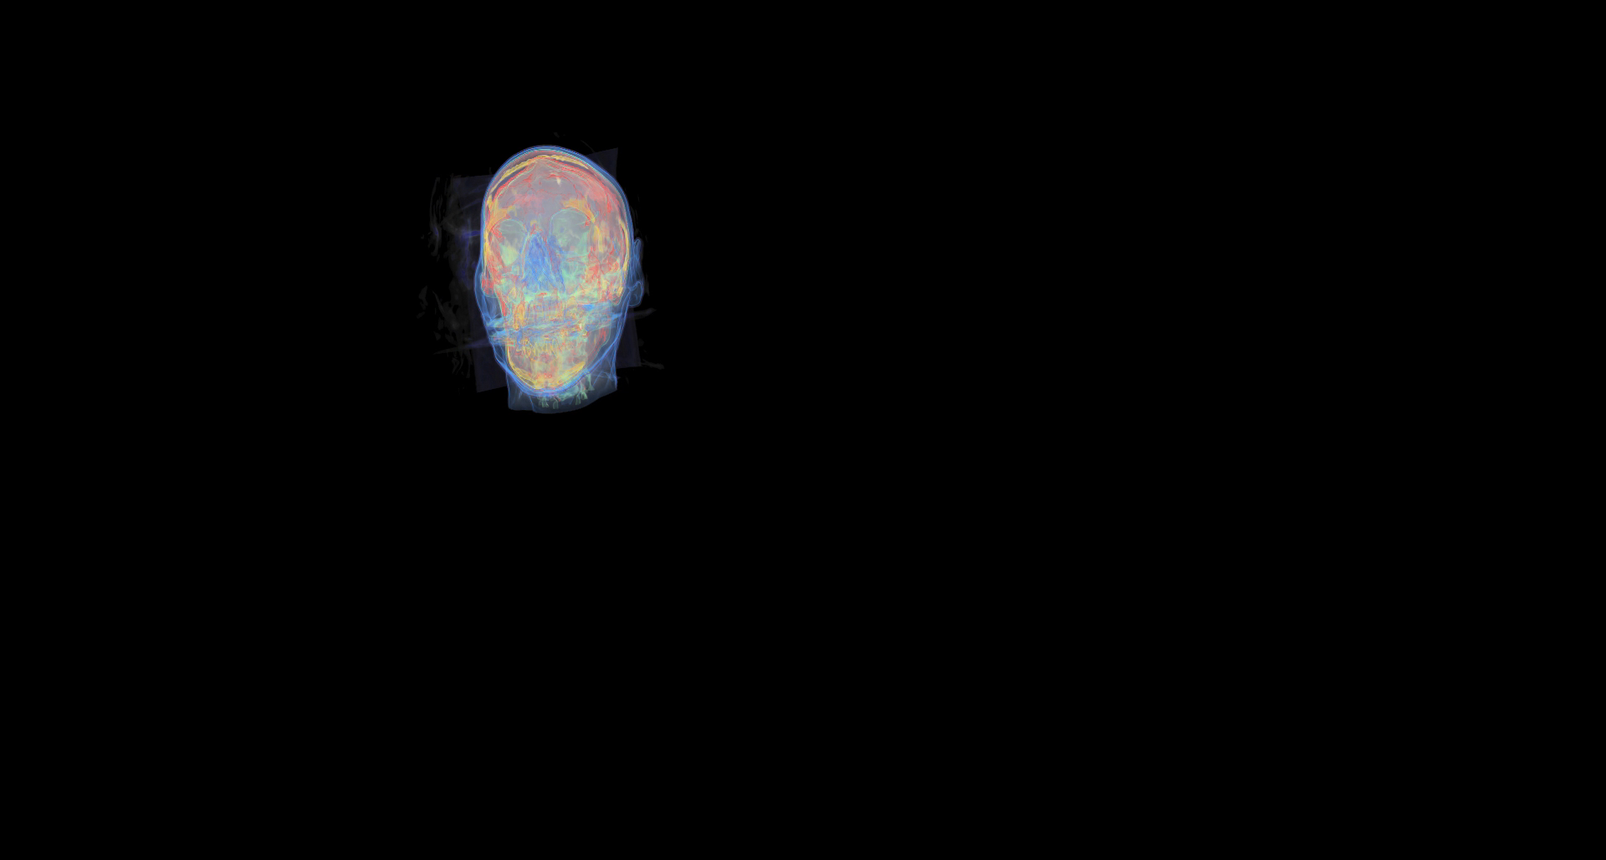
Texture Based
Pre‐integrated
IsoSurface Rendering
Team 6
Kaixin Yao, Siyuan Zhang
This is Result

Slide 2
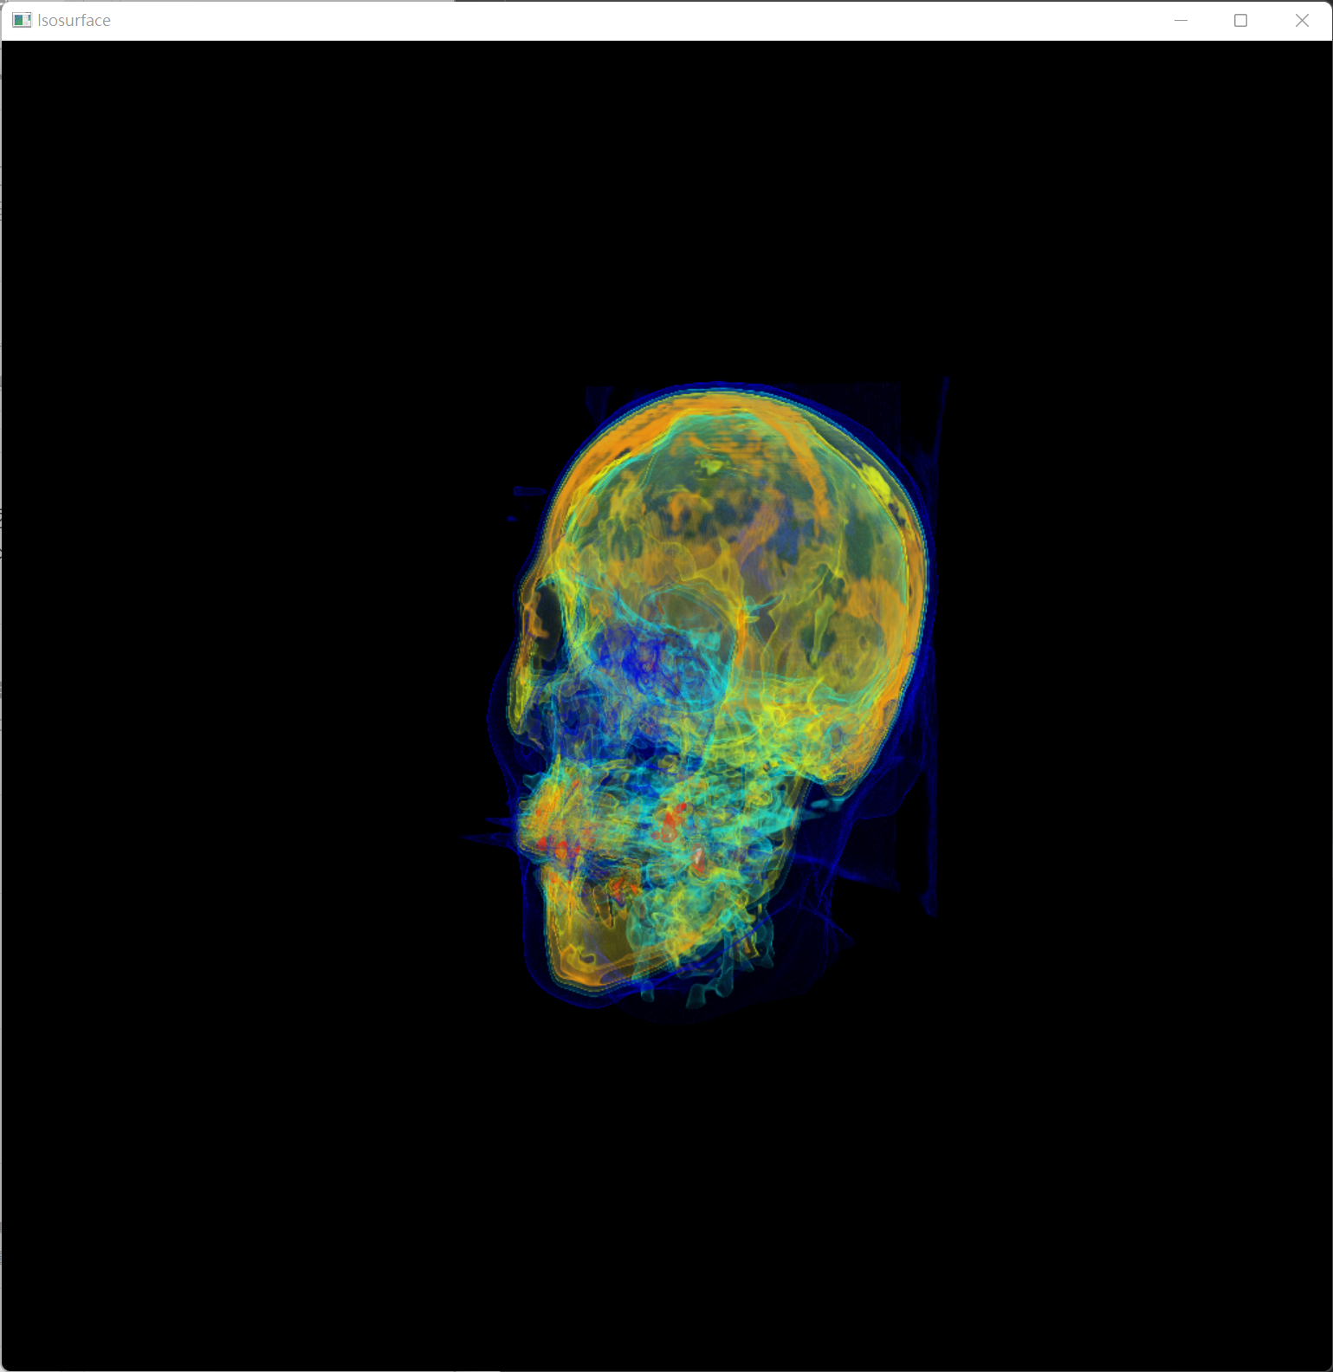
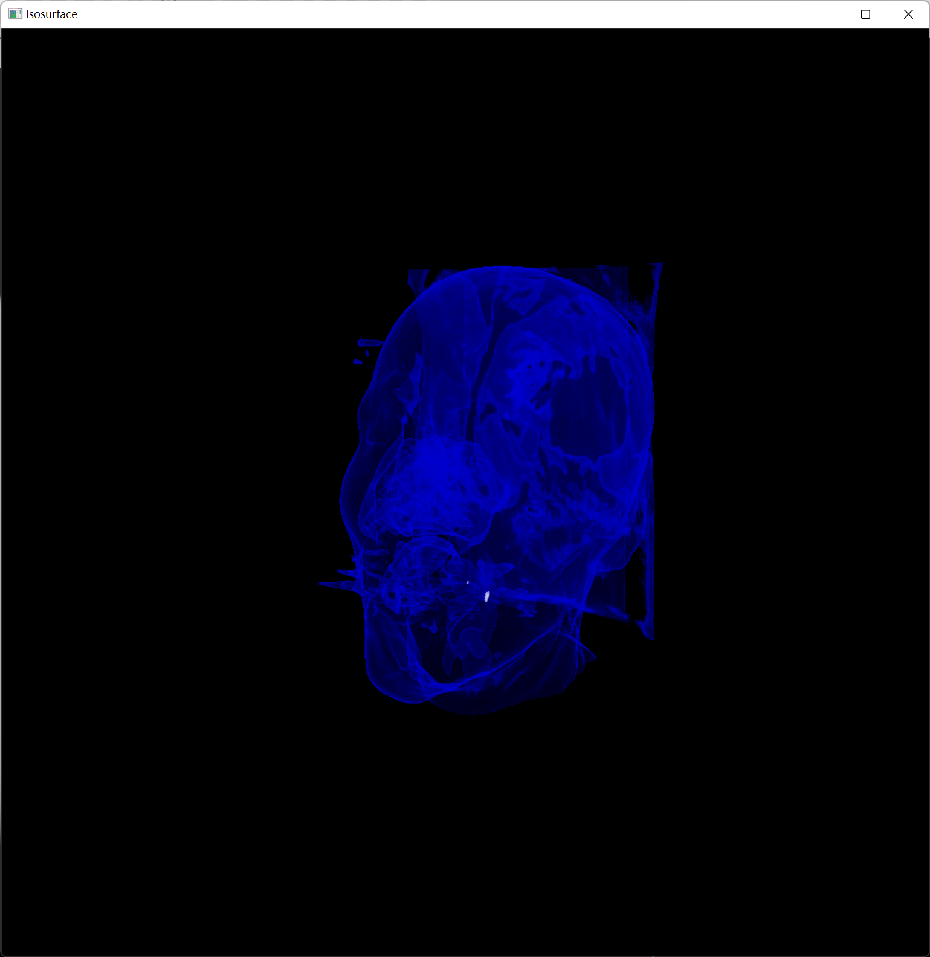
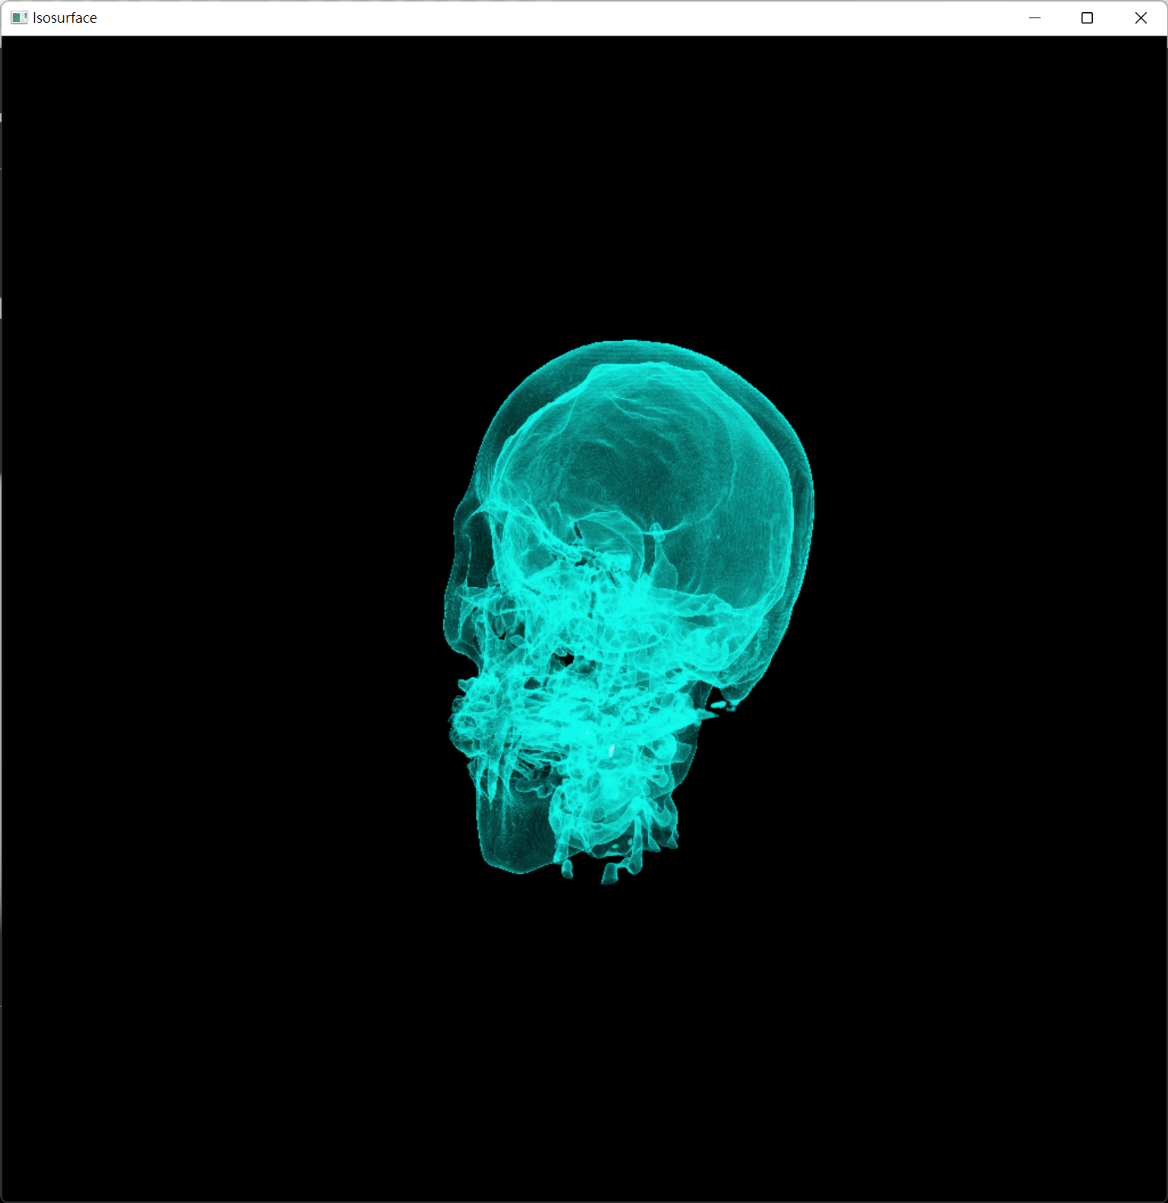
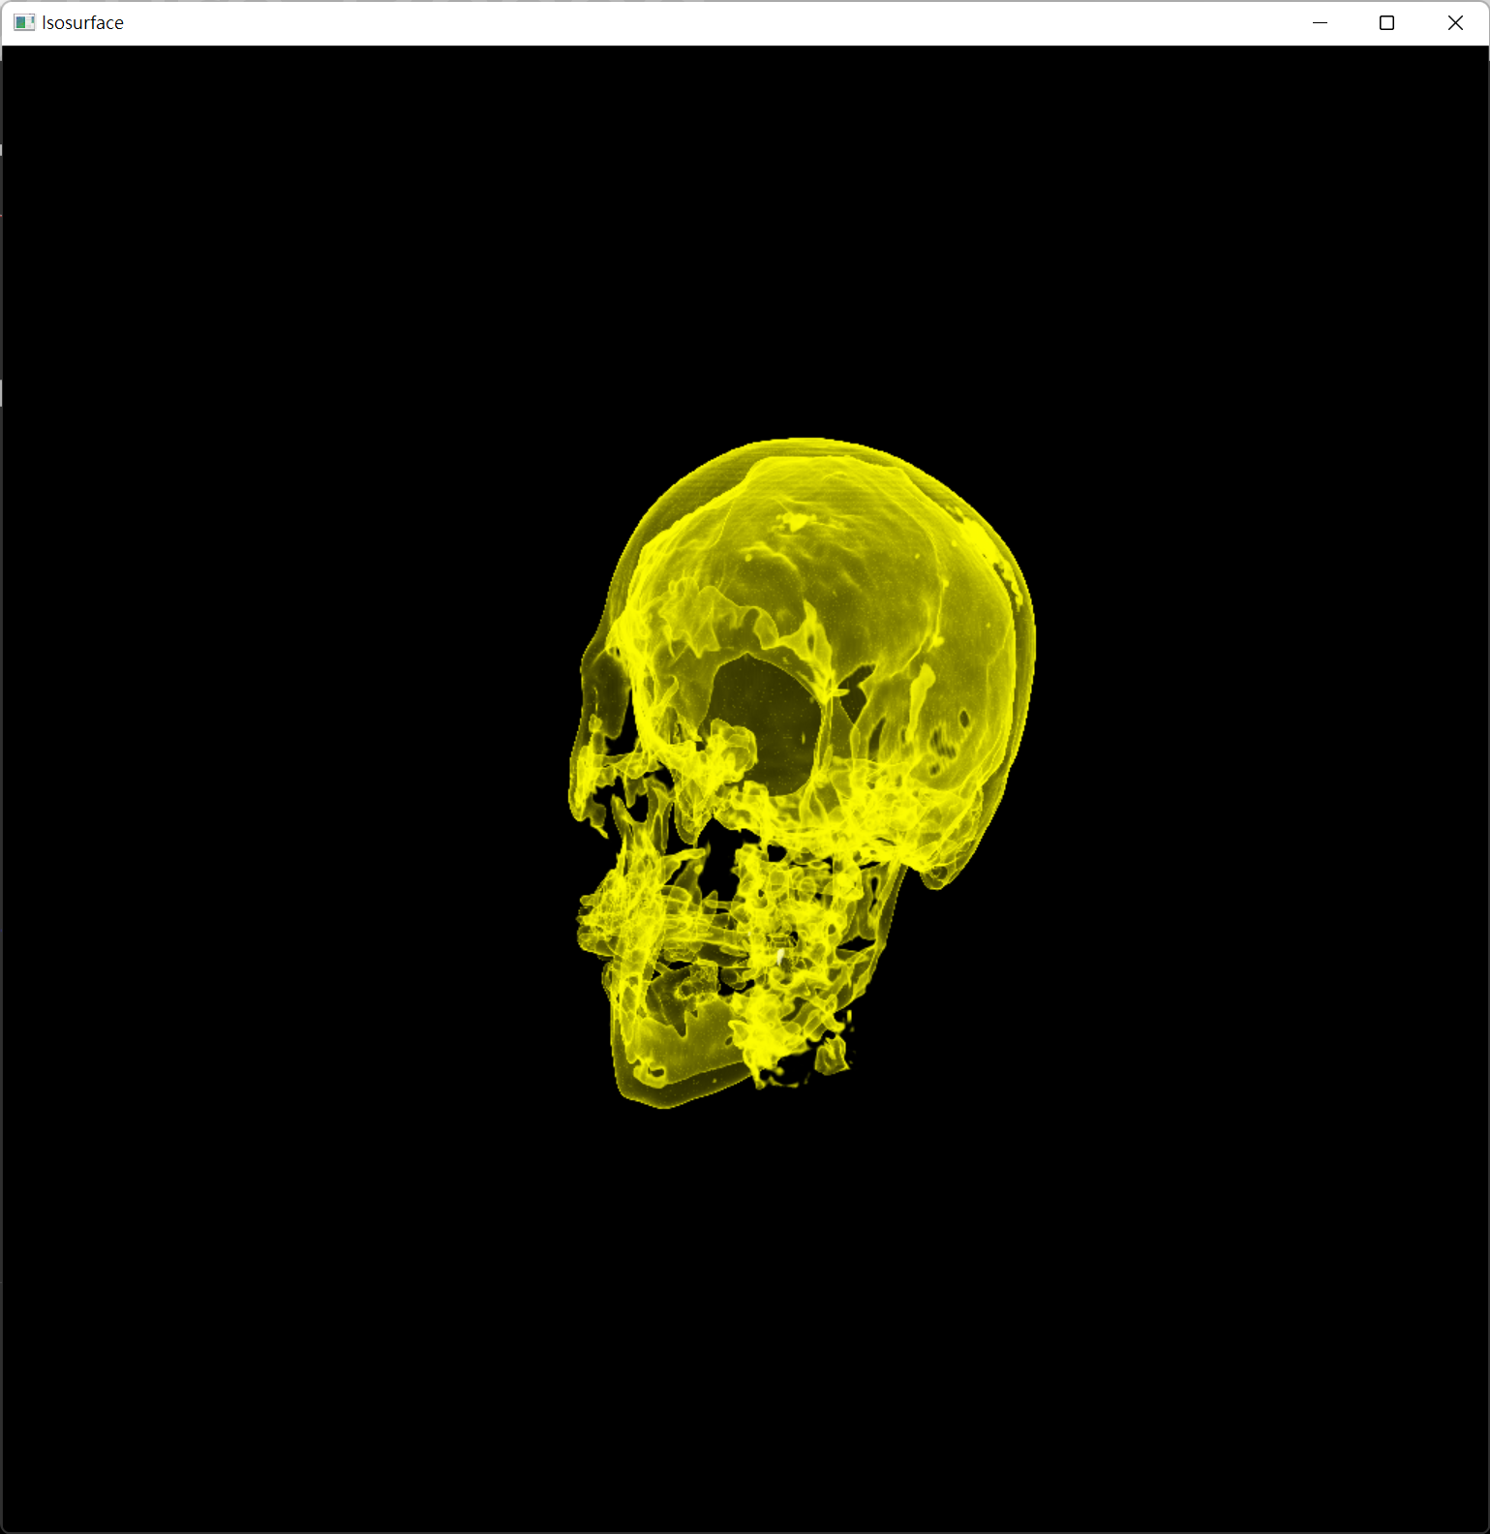
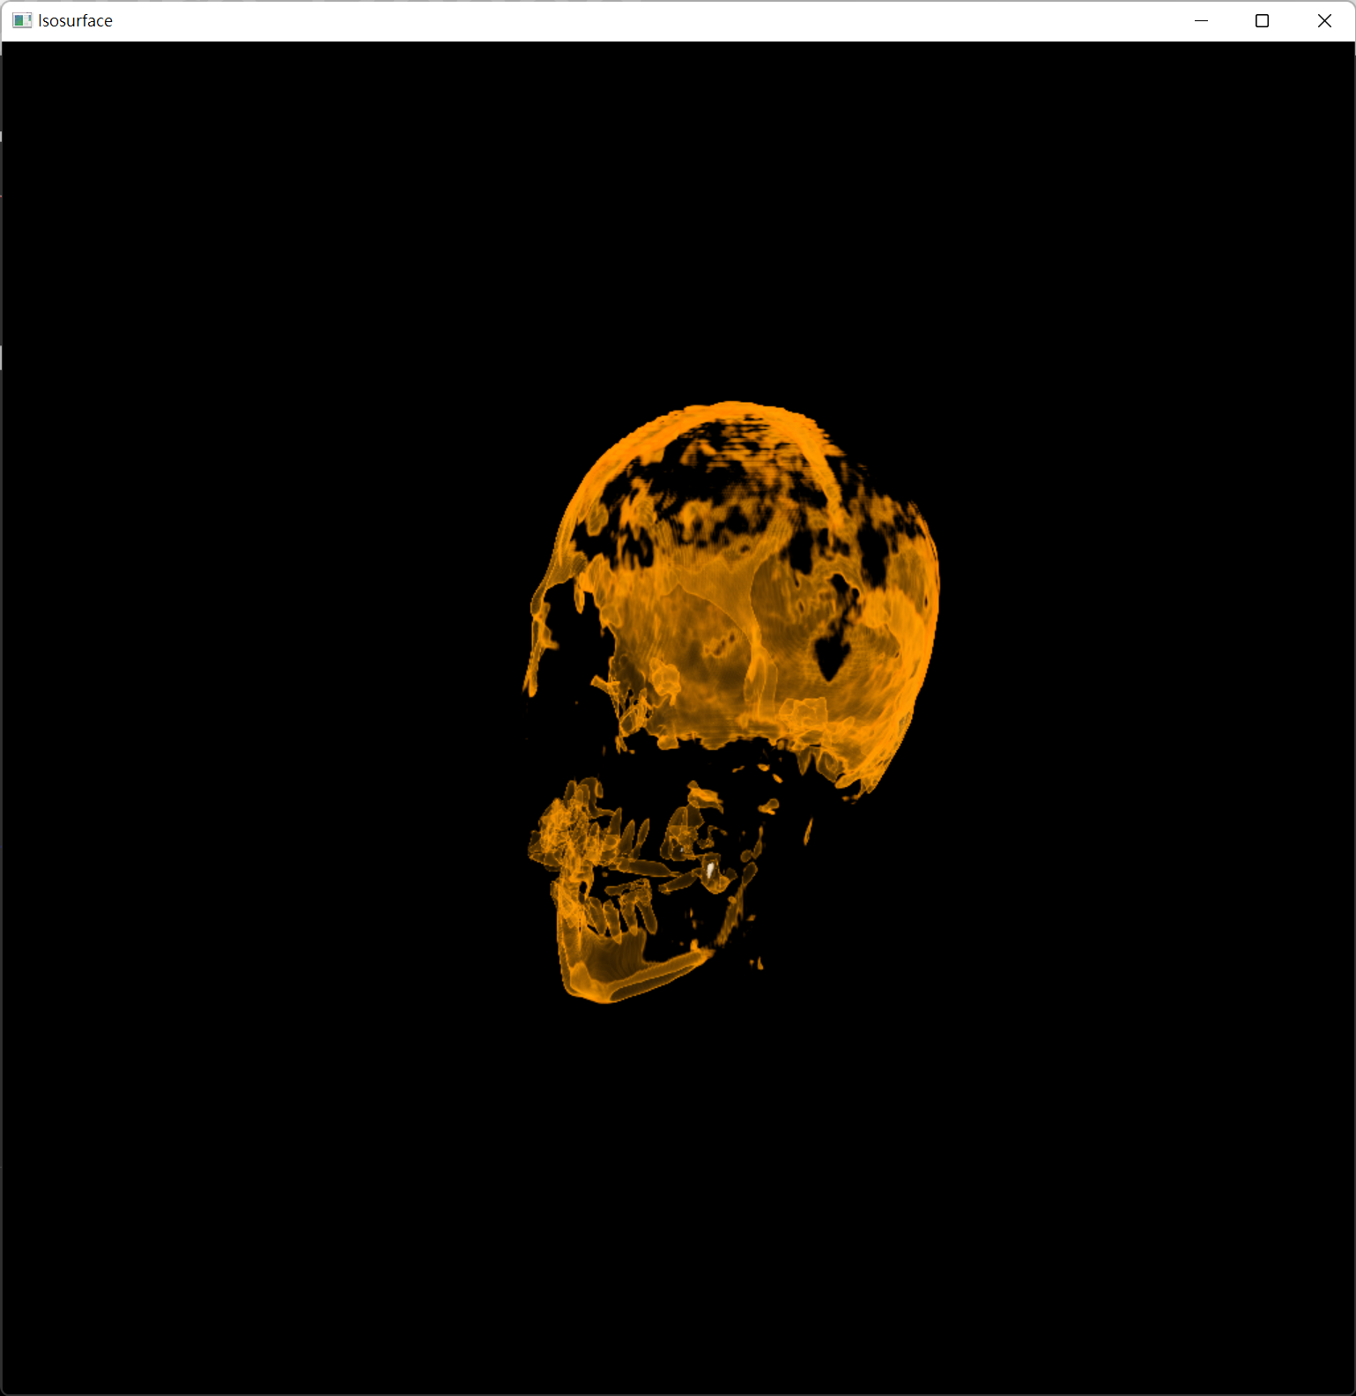
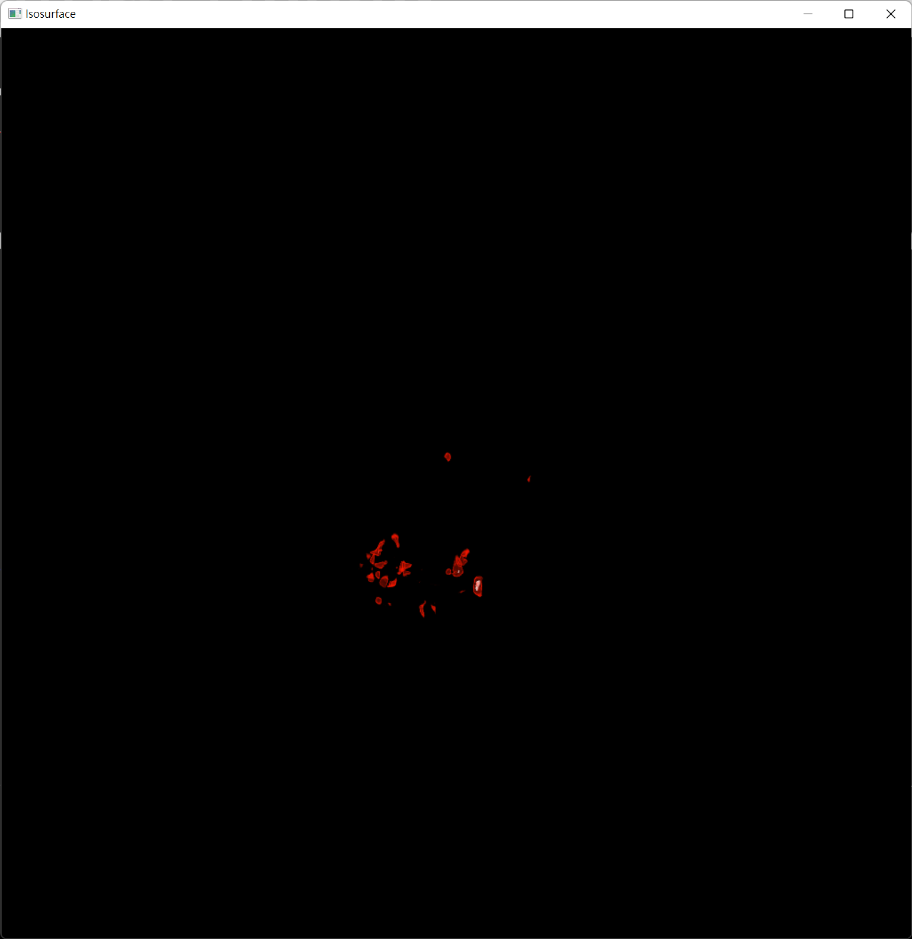
Texture Based
Pre‐integrated
IsoSurface Rendering
What is isosurface?
An approximately constant value surface within a volume
How to render isosurface?
Marching cubes
ray casting
Composition with box opacity function
Notes:
什么是isosurface
等值面是一个三维数据分布中数值相等的点的三维表面表示。是三维等值线。
一个等值面可以用来表示，例如，一个图像中具有给定CoLocalization水平的所有VoXels。这些点被连接起来形成一个三维表面。可能发生的情况是，这个表面被分割成几个不相连的部分：它们成为可以独立分析的对象。
你也可以通过观察等值面的计算方式来理解它。三维数据集首先在某一水平上被阈值化。等值面是包裹着剩余体素的表面。如果这些体素分布在没有空间联系的组中，你实际上会得到许多不同的非连接面。(每一组相连的体素都可以被标记为一个独立的物体）。因此，一个等值面是包围所有这些对象的（多）面。该表面所包围的所有体素的强度都高于阈值。

Slide 3
Texture Based
Pre‐integrated
IsoSurface Rendering
By Ray Casting
Ray match
Optics data retrieving
Integration
Volume data sampling
memory locality problem
when indexing the volume data
Interpolation
Transfer Function
Front to Back

Slide 4
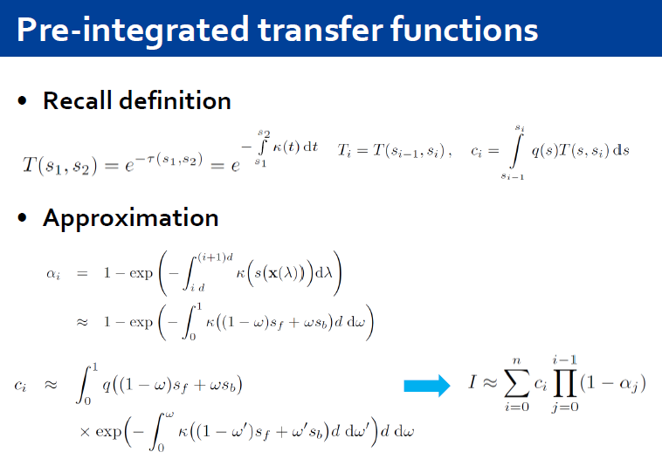
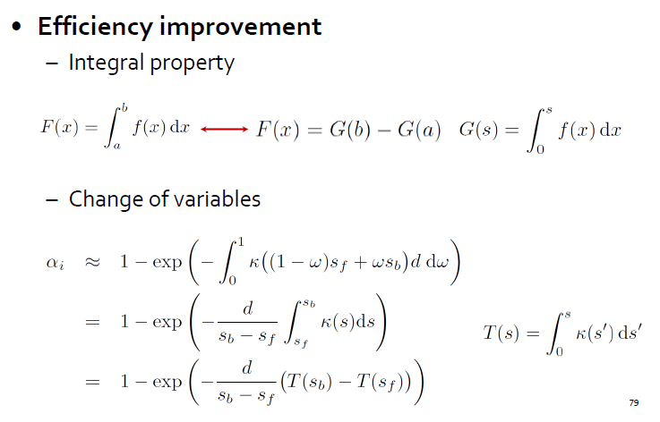
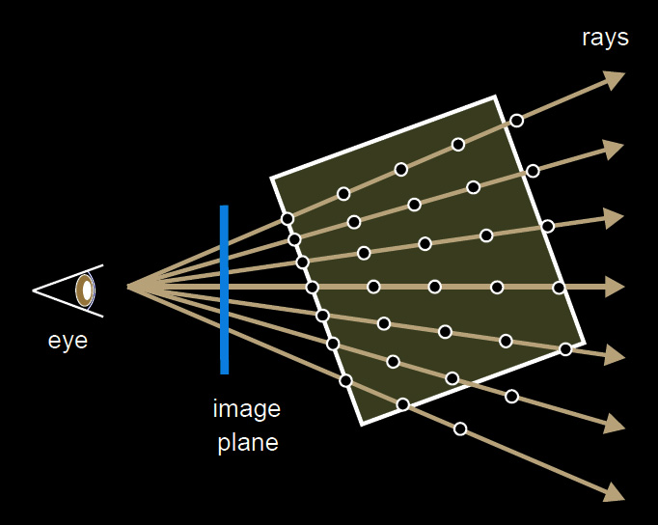
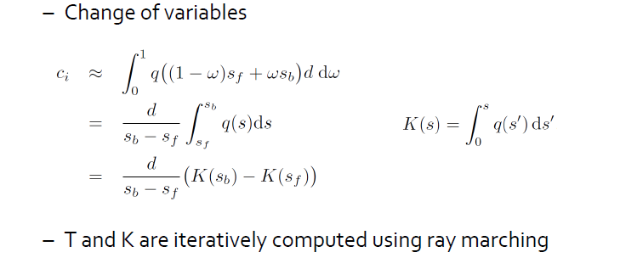
Texture Based
Pre‐integrated
IsoSurface Rendering
Recall Mathmatic in the Course…
Pre-interpolative
transfer function
Post-interpolative
transfer function
Pre-integrated
transfer function

Slide 5
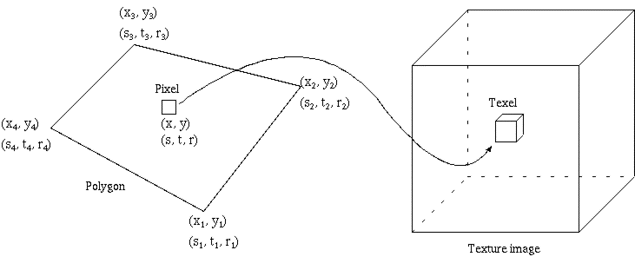
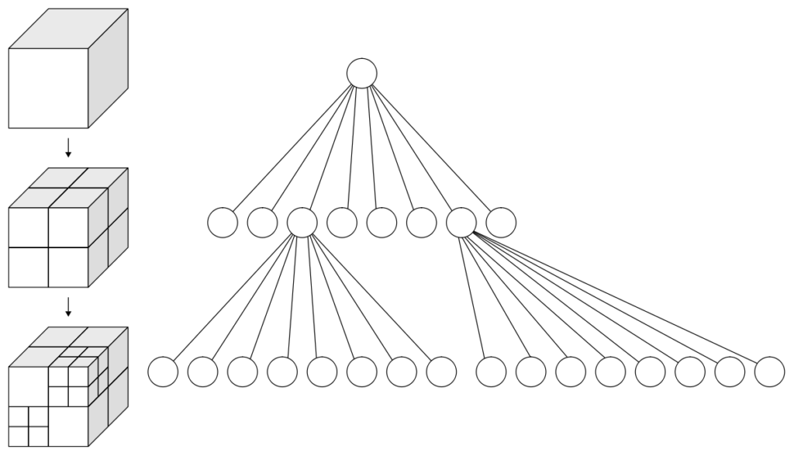
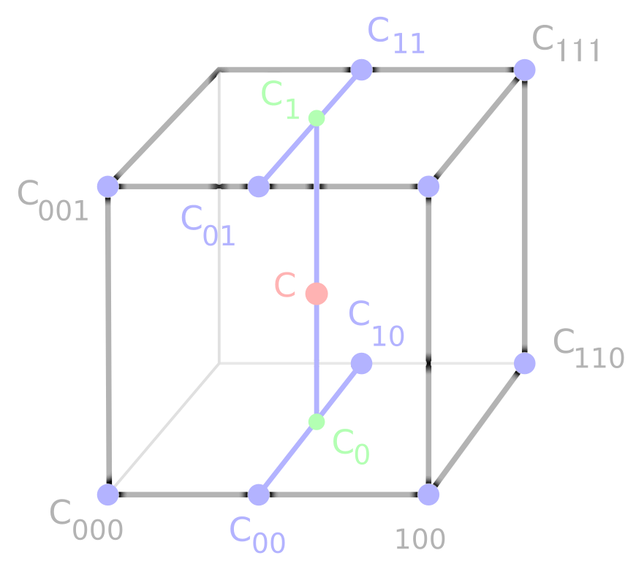
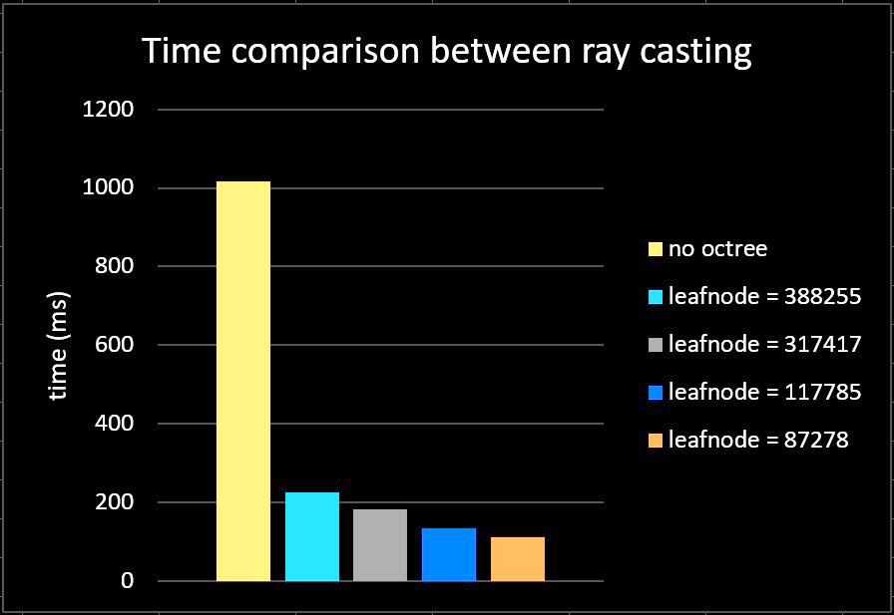
Texture Based
Pre‐integrated
IsoSurface Rendering
VS Octree
Auto
Interpolation
By OpenGL
Realtime≡
Not Fast Enough
Credit https://web.cs.ucdavis.edu/~okreylos/PhDStudies/Winter2000/TextureMapping.html
https://developer.nvidia.com/gpugems/gpugems/part-vi-beyond-triangles/chapter-39-volume-rendering-techniques
Notes:
3 d 纹理允许直接处理体积数据
体积数据直接下载到图形硬件中，并直接用于计算被渲染原语覆盖的每个像素的颜色和不透明度值

Slide 6
Texture Based
Pre‐integrated
IsoSurface Rendering
Ray match
Optics data retrieving
Integration
Volume data sampling
This is Result

Slide 7
Result
Talk is cheap show me your demo

Slide 8
Program
Demo is great
show me your code

Slide 9

Code Architecture
Render (passing uniform) &
Camera Control
RayCasting.h
ArcBall.h
Other Uniform data
Fragment
Ray Intersect Box
1D Pre-Integrate
<texture1D>
Rendering
2D Pre-Integrate
<texture2D>
Transfer Function encode &
TF interactive UI &
Pre-Integrate
Transferfunction.h
Ray trace
Sample Volume get Iso Value
Sample Pre-Integrate 1D
Volume file read decode &
load to OpenGL
VolumeData.h
Volume
<texture3D>
Sample Pre-Integrate 2D

Slide 10
Code Transfer Function
Render (passing uniform) &
Camera Control
RayCasting.h
ArcBall.h
void TransferFunction::calculatePreIntegration1D() { #pragma omp parallel for for (int i = 0; i < TABLESIZE; i++) { CDFtable[i][0] = 0.0f; CDFtable[i][1] = 0.0f; CDFtable[i][2] = 0.0f; CDFtable[i][3] = 0.0f; } float sum[4] = {0.0f, 0.0f, 0.0f, 0.0f}; for (int i = 0; i < TABLESIZE; i++) { sum[0] += float(colortable[i][0]) / 255.0f * (float(colortable[i][3]) / 255.0f); sum[1] += float(colortable[i][1]) / 255.0f * (float(colortable[i][3]) / 255.0f); sum[2] += float(colortable[i][2]) / 255.0f * (float(colortable[i][3]) / 255.0f); sum[3] += float(colortable[i][3]) / 255.0f; CDFtable[i][0] = sum[0]; CDFtable[i][1] = sum[1]; CDFtable[i][2] = sum[2]; CDFtable[i][3] = sum[3]; } glBindTexture(GL_TEXTURE_1D, PLut); glTexImage1D(GL_TEXTURE_1D, 0, GL_RGBA32F_ARB, TABLESIZE, 0, GL_RGBA, GL_FLOAT, CDFtable); glBindTexture(GL_TEXTURE_1D, Lut); GL::CheckErrors(); }
Transfer Function encode &
TF interactive UI &
Pre-Integrate
Transferfunction.h
Volume file read decode &
load to OpenGL
VolumeData.h

Slide 11
Code Transfer Function
Render (passing uniform) &
Camera Control
RayCasting.h
ArcBall.h
void TransferFunction::calculatePreIntegration2D() { #pragma omp parallel for collapse(2) for (int j = 0; j < TABLESIZE; j++) for (int i = 0; i < TABLESIZE; i++) { PDFTable[j][i][0] = 0.0f; PDFTable[j][i][1] = 0.0f; PDFTable[j][i][2] = 0.0f; PDFTable[j][i][3] = 0.0f; } for (int j = 0; j < TABLESIZE; j++) for (int i = 0; i < TABLESIZE; i++) { if (j != i) { float delta = 1.0f; float stepCompensation = 1.0f / float(abs(j - i)); if (j > i) { for (float fj = float(j); fj > float(i); fj -= delta) { float alpha = (float(colortable[int(fj)][3]) / 255.0f) * stepCompensation; PDFTable[j][i][0] += (1 - PDFTable[j][i][3]) * (float(colortable[int(fj)][0]) / 255.0f) * alpha; PDFTable[j][i][1] += (1 - PDFTable[j][i][3]) * (float(colortable[int(fj)][1]) / 255.0f) * alpha; PDFTable[j][i][2] += (1 - PDFTable[j][i][3]) * (float(colortable[int(fj)][2]) / 255.0f) * alpha; PDFTable[j][i][3] += (1 - PDFTable[j][i][3]) * alpha; } } else { for (float fj = float(j); fj < float(i); fj += delta) { float alpha = (float(colortable[int(fj)][3]) / 255.0f) * stepCompensation; PDFTable[j][i][0] += (1 - PDFTable[j][i][3]) * (float(colortable[int(fj)][0]) / 255.0f) * alpha; PDFTable[j][i][1] += (1 - PDFTable[j][i][3]) * (float(colortable[int(fj)][1]) / 255.0f) * alpha; PDFTable[j][i][2] += (1 - PDFTable[j][i][3]) * (float(colortable[int(fj)][2]) / 255.0f) * alpha; PDFTable[j][i][3] += (1 - PDFTable[j][i][3]) * alpha; } } if (PDFTable[j][i][3] != 0.0) { //convert back to C for c PDFTable[j][i][0] /= PDFTable[j][i][3]; PDFTable[j][i][1] /= PDFTable[j][i][3]; PDFTable[j][i][2] /= PDFTable[j][i][3]; } } else { PDFTable[j][i][0] = float(colortable[i][0]) / 255.0f; PDFTable[j][i][1] = float(colortable[i][1]) / 255.0f; PDFTable[j][i][2] = float(colortable[i][2]) / 255.0f; PDFTable[j][i][3] = float(colortable[i][3]) / 255.0f; } } glBindTexture(GL_TEXTURE_2D, PLut2D); glTexImage2D(GL_TEXTURE_2D, 0, GL_RGBA32F_ARB, TABLESIZE, TABLESIZE, 0, GL_RGBA, GL_FLOAT, PDFTable); GL::CheckErrors(); glBindTexture(GL_TEXTURE_1D, Lut); }
Transfer Function encode &
TF interactive UI &
Pre-Integrate
Transferfunction.h
Volume file read decode &
load to OpenGL
VolumeData.h

Slide 12
Code Transfer Function
Render (passing uniform) &
Camera Control
RayCasting.h
ArcBall.h
COLORTABLE
Discrete Transfer Function
CDF
PreIntegration1D
R
R ….
R1
R2
R3
∫R1A1
∫RiAi
G
G ….
G1
G2
G3
∫G1A1
∫GiAi
B
B ….
B1
B2
B3
∫B1B1
∫BiAi
Transfer Function encode &
TF interactive UI &
Pre-Integrate
Transferfunction.h
A
A ….
A1
A2
A3
∫ A1
∫ Ai
PDF
PreIntegration2D
R
G
PDF[R][i][j] = CDF[R][i] – CDF[R][j]
PDF[R][i][j] = CDF[G][i] – CDF[G][j]
Volume file read decode &
load to OpenGL
VolumeData.h
B
A
PDF[B][i][j] = CDF[B][i] – CDF[B][j]
PDF[A][i][j] = CDF[A][i] – CDF[A][j]

Slide 13
Code Transfer Function
COLORTABLE
Discrete Transfer Function
CDF
PreIntegration1D
Interpolation by OpenGL
R
R ….
R1
R2
R3
∫R1A1
∫RiAi
G
G ….
G1
G2
G3
∫G1A1
∫GiAi
B
B ….
1D Pre-Integrate
<texture1D>
B1
B2
B3
∫B1B1
∫BiAi
A
A ….
A1
A2
A3
∫ A1
∫ Ai
Texturesampler 1D/ 2D
PDF
PreIntegration2D
R
G
2D Pre-Integrate
<texture2D>
PDF[R][i][j] = CDF[R][i] – CDF[R][j]
PDF[R][i][j] = CDF[G][i] – CDF[G][j]
B
A
PDF[B][i][j] = CDF[B][i] – CDF[B][j]
PDF[A][i][j] = CDF[A][i] – CDF[A][j]

Slide 14
Code Architecture
vec4 lastCDF = vec4(0); vec4 currentCDF = vec4(0); float lastValuef = 0; while (result.a < 1.0 && raylength < len) { vec3 pos = front+raylength*norm_dir; // find next pos vec4 texValue = vec4(0); valuef = texture3D(blockPool, pos).a; // get isovalue of the next pos and interpolation by opengl
Fragment
Ray Intersect Box
{ //1D pre-integration currentCDF = texture1D(CDFtranf, valuef); // get CDF[isovalue] // calculate the accumulation
float dv = abs(lastValuef - valuef) * 255.0; float da = abs(lastCDF.a - currentCDF.a); if (dv == 0.0 || da == 0.0) texValue = texture1D(tranf, valuef); else { texValue.a = da/dv; texValue.rgb = abs(lastCDF.rgb - currentCDF.rgb)/da; } }
Rendering
Ray trace
{ // 2D pre-integration texValue = texture2D(preInt2D, vec2(valuef, lastValuef)); }
Sample Volume get Iso Value
// integrate on the ray
lastCDF = currentCDF; lastValuef = valuef; texValue.a = texValue.a *stepsize *sizeX; result.rgb += (1.0-result.a)*texValue.a*texValue.rgb; result.a += (1.0-result.a)*texValue.a; raylength += stepsize;
}
Sample Pre-Integrate 1D
Sample Pre-Integrate 2D

Slide 15
Code Architecture
Render (passing uniform) &
Camera Control
RayCasting.h
ArcBall.h
Other Uniform data
Fragment
Ray Intersect Box
1D Pre-Integrate
<texture1D>
Rendering
2D Pre-Integrate
<texture2D>
Transfer Function encode &
TF interactive UI &
Pre-Integrate
Transferfunction.h
Ray trace
Sample Volume get Iso Value
Sample Pre-Integrate 1D
Volume file read decode &
load to OpenGL
VolumeData.h
Volume
<texture3D>
Sample Pre-Integrate 2D

Slide 16


Contribution
Fragment
Volume file read decode &
load to OpenGL
VolumeData.h
Ray Intersect Box
Sample Pre-Integrate 2D
Kaixin Yao
yaokxx
Pre-Integrate 2D
Transferfunction.h
Main Speak person
Render (passing uniform)
Camera Control
RayCasting.h
ArcBall.h
Rendering
Main PPT maker
Transfer Function encode &
TF interactive UI &
Pre-Integrate
Transferfunction.h
Ray trace
Sample Volume get Iso Value
Siyuan Zhang
murez
Sample Pre-Integrate 1D
Baseline of the fragment

Slide 17
3RD Libs & Resources
FreeGLUT glut OpenGL GUI
GLEW OpenGL API
GLM OpenGL Math
GLlib Some OpenGL Encapsulated Functions
Jet.cpp Color map generate
ArchBall.cpp mouse control
CT-HEAD.bin, Flame.bin volume data from yuehaowang

Slide 18
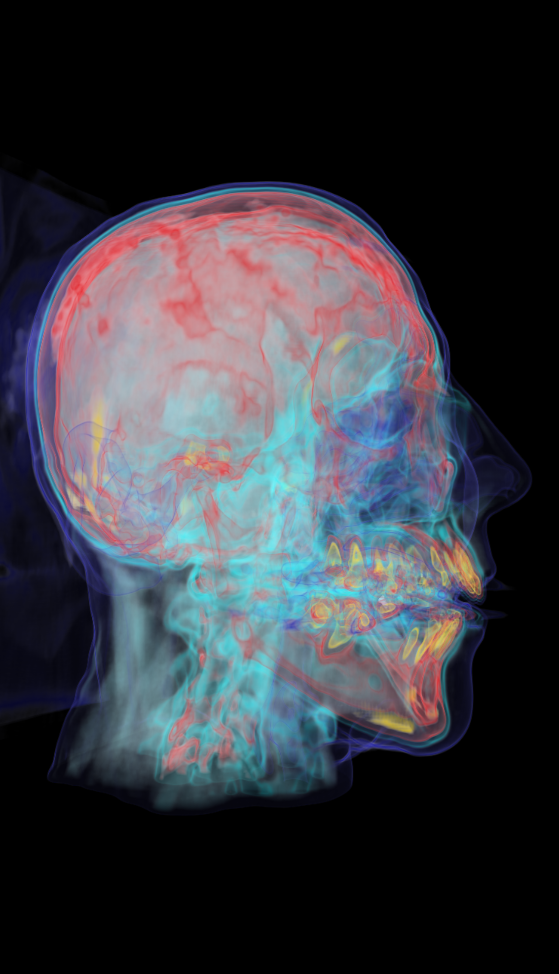
Future Work
texture2D volume
Gaussian Transfer Function
More stable GUI
Faster PreIntegration1D/2D calculation
omp/cuda/glsl

Slide 19
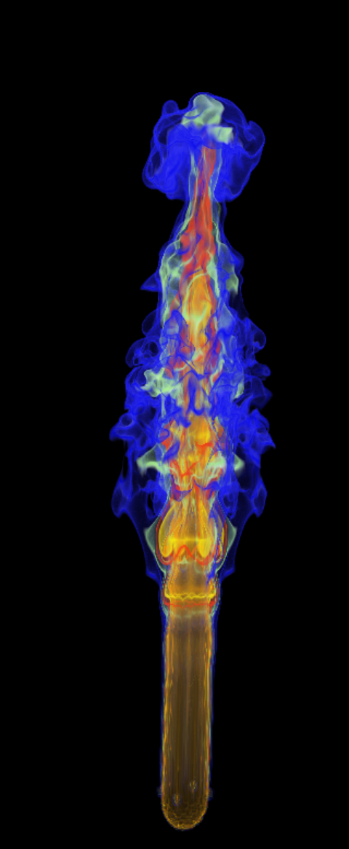
QA

